Slide 1

Department of ECE
EMBEDDED PROTOTYPE
Real-Time Vehicle-to-Vehicle Communication System for Collision Prevention and Emergency Priority
GUIDED BY:-
Dr.N.PRABAKARAN Associate Professor Dept of ECE
PRESENTED BY:-
B NANDIVARDHAN REDDY(2300049094)
R. GAYATRI(2300049060)
ARUMILLI GOVARSHITHA(2300049132)

Slide 2


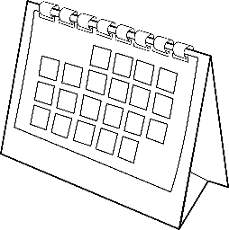
Objective
Develop real-time V2V communication between vehicles.
Provide collision warning and sudden brake alerts.
Detect accidents using sensors.
Enable emergency vehicle priority mode.
Implement hazard memory for cooperative awareness.
Use low-latency wireless communication.

Slide 3
Problem Statement
Road accidents occur due to lack of communication between vehicles and delayed driver response. Emergency vehicles also face traffic delays due to low awareness. Current safety technologies are expensive and not accessible to all vehicles.
Road accidents occur due to lack of communication between vehicles.
Drivers cannot predict sudden braking or nearby hazards.
Emergency vehicles face delays in traffic.
Advanced safety systems are expensive and limited to high-end vehicles.

Slide 4
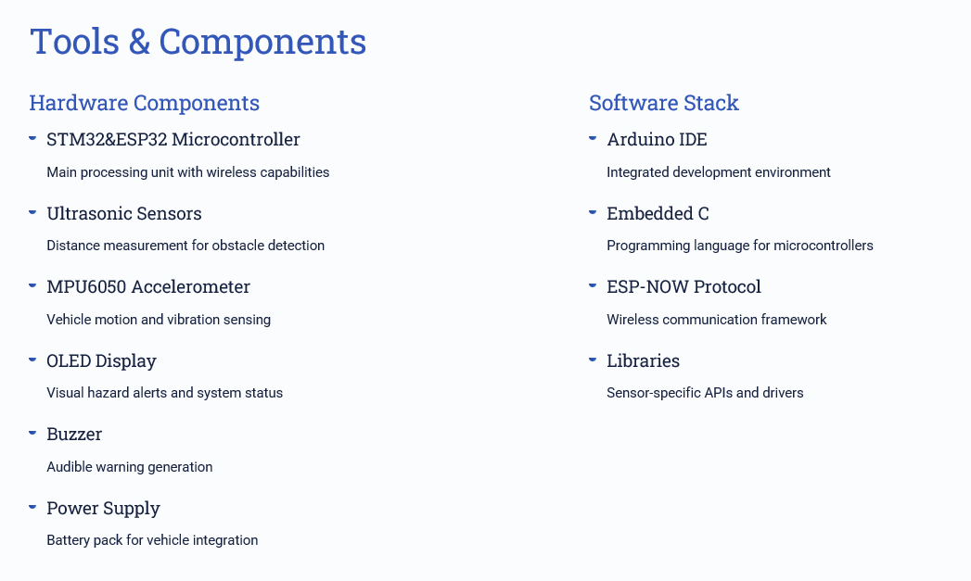
Hardware & Software Tools

Slide 5
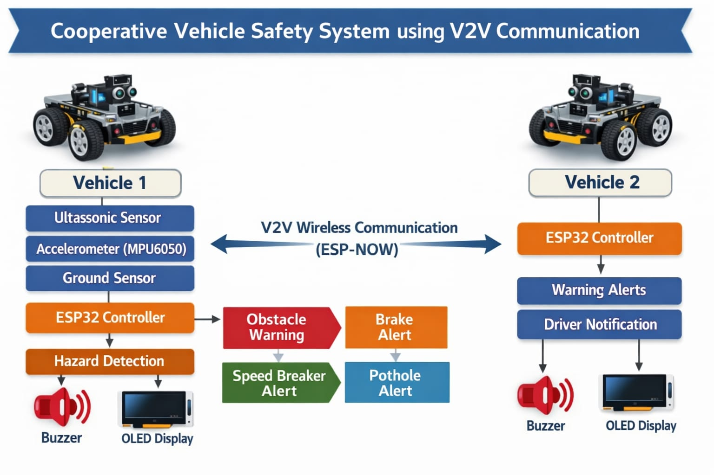
Block Diagram

Slide 6





Methodology / Working
Sensor Detection
Ultrasonic sensors and accelerometer continuously monitor road conditions and vehicle state
Data Processing
ESP32 processes raw sensor data and identifies potential hazards in real-time
Speed Calculation
Vehicle speed determined from motion sensors for transmission to nearby vehicles
Memory Storage
Hazard information stored with location and timestamp for historical reference
Wireless Transmission
ESP-NOW protocol broadcasts hazard data to nearby vehicles instantly

Slide 7
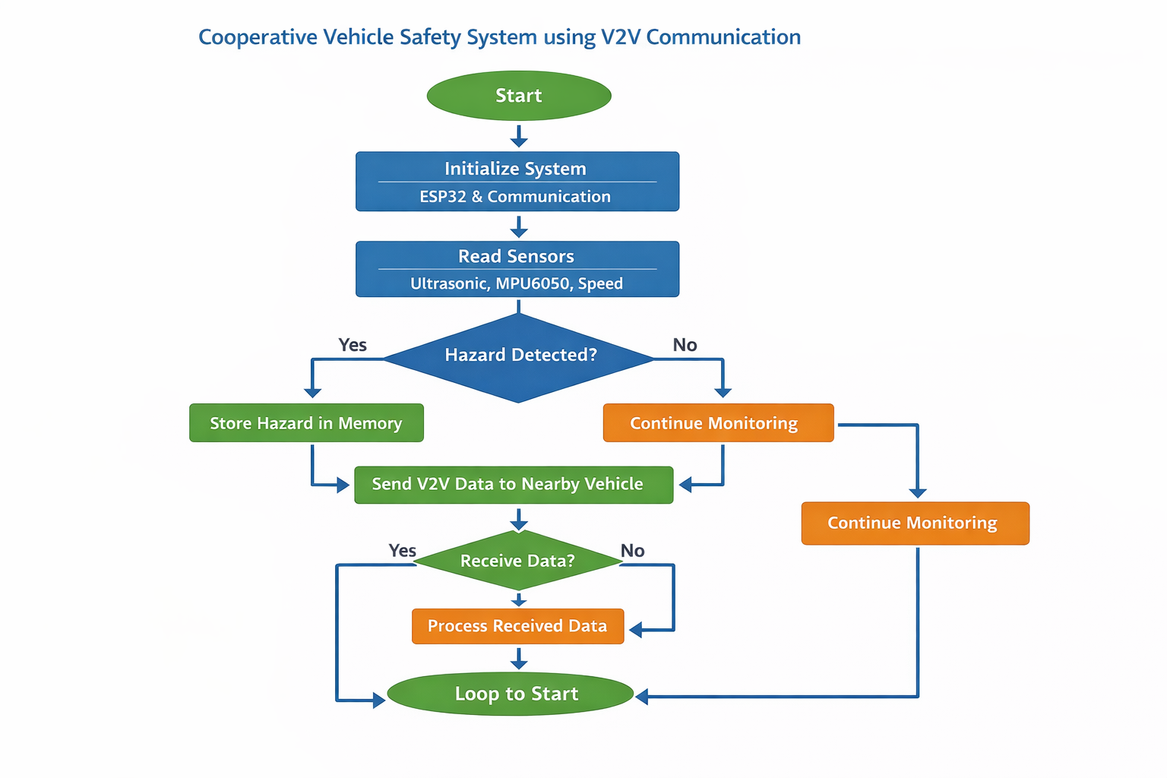
Flowchart

Slide 8
Conclusion & Future Scope
Conclusion:
Demonstrated a low-cost cooperative vehicle safety system.
Achieved real-time communication between vehicles.
Improved awareness and emergency response capability.
Future Scope:
Integration with GPS and cloud
Automotive-grade controllers (CAN)
Smart traffic signal integration
Multi-vehicle network

Slide 9


THANK YOU
EMBEDDED PROTOTYPE

